Slide 1
Níveis de Modularidade
‘Modularidade: Conectando padrões e processos em evolução multivariada’

Slide 2
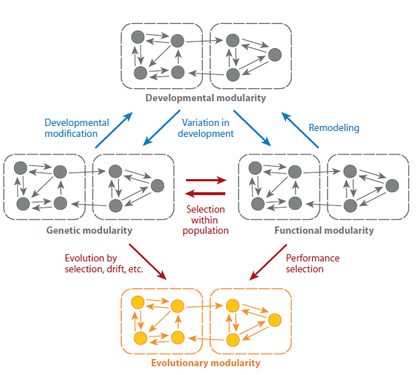
PATTERNS WITHIN POPULATION/
SPECIES
INDIVIDUAL
PROCESSES
PATTERNS
ACROSS
SPECIES
POPULACIONAL
PROCESSES
Cheverud 1996
Klingenberg 2008

Slide 3
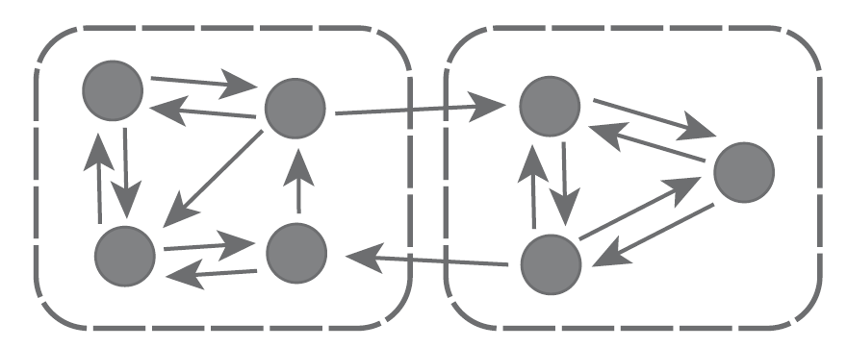
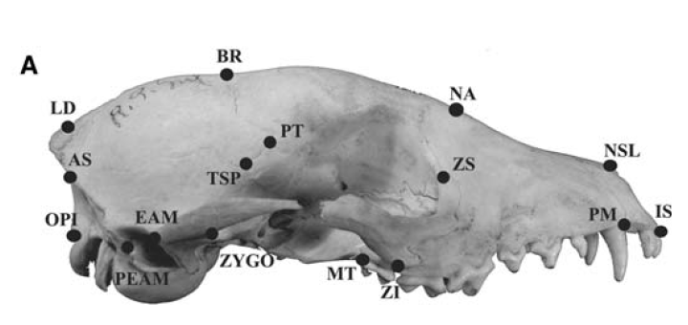
Pattern and magnitude of integration
Porto et al. 2009

Slide 4

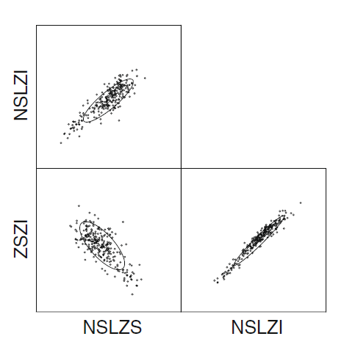
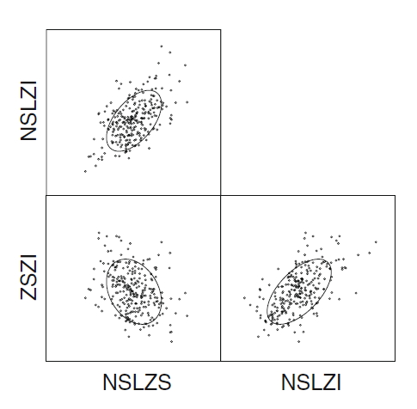
Same pattern, different magnitude of integration
r = 0.85
r = 0.45

Slide 5
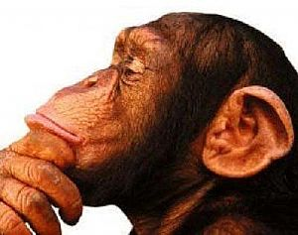
What processes determine the patterns and magnitudes of integration???

Slide 6
INDIVIDUAL
PROCESSES
POPULACIONAL
PROCESSES

Slide 7
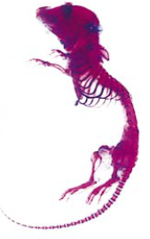
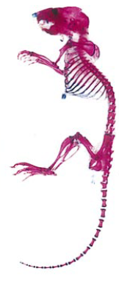
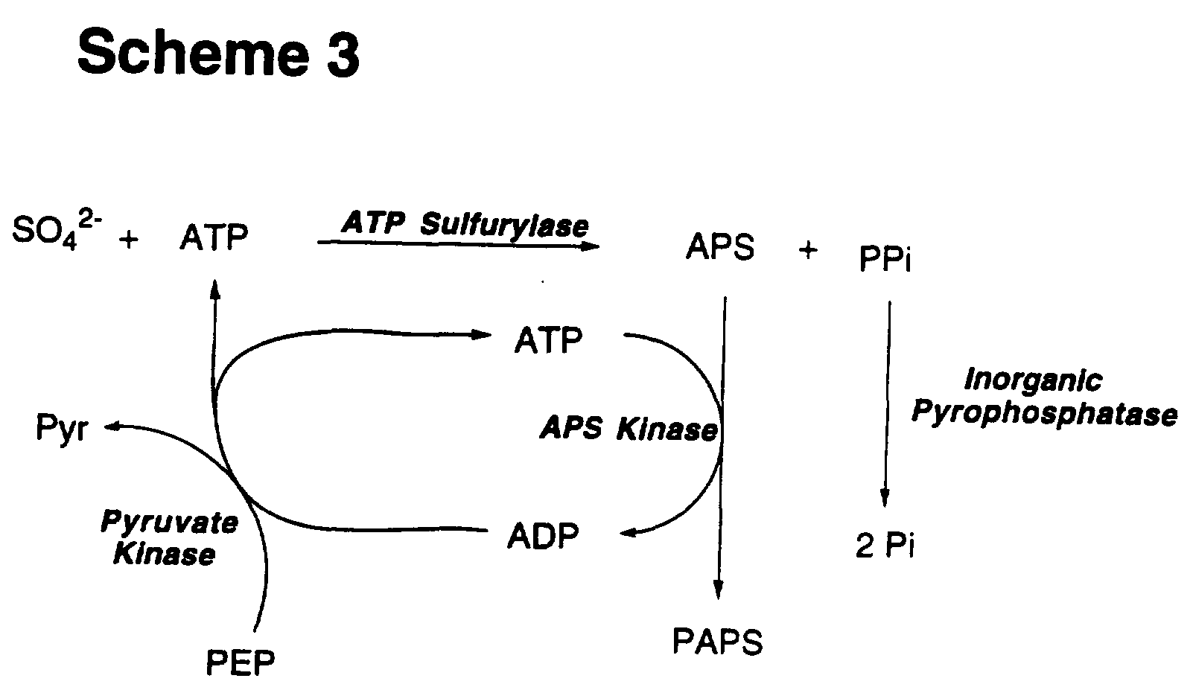
Developmental modification:
genetic to developmental modularity
Single mutation

Slide 8
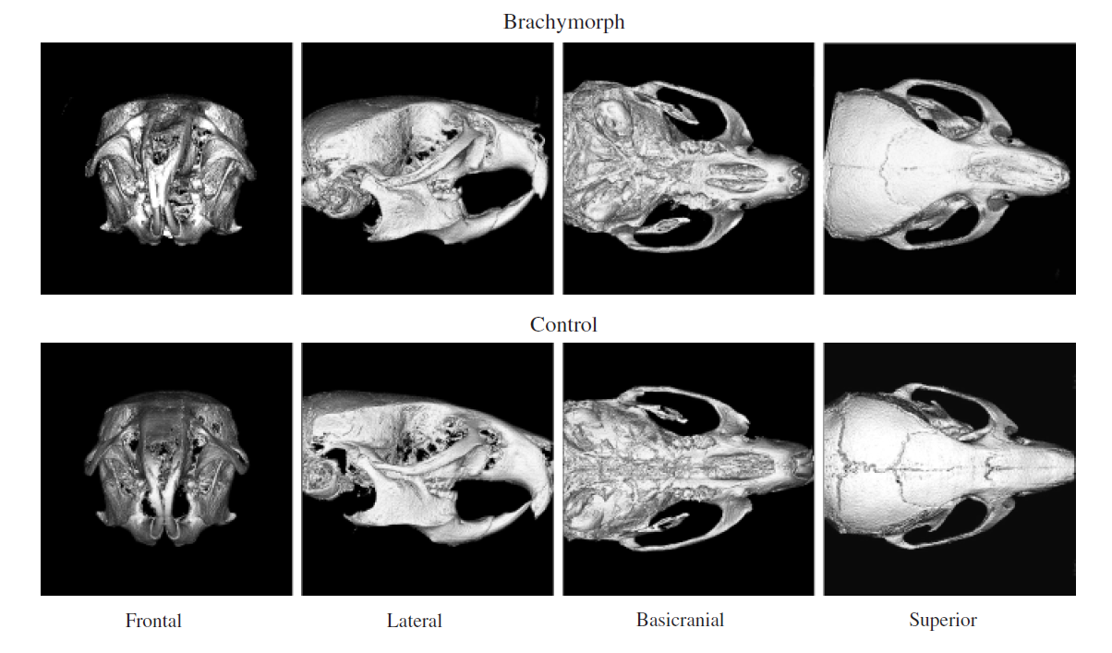
Brachyomorph phenotype
Hallgrímsson et al. 2006

Slide 9
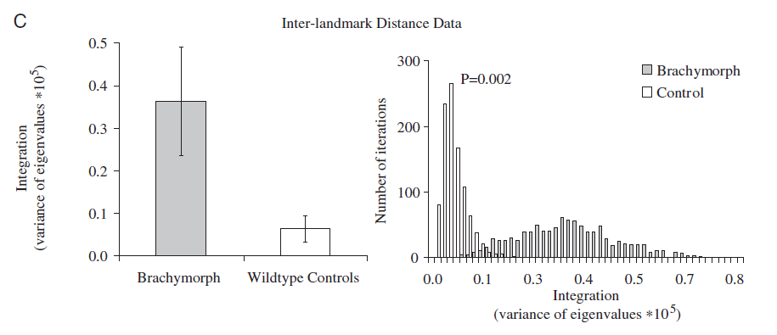
Higher integration in the
brachyomorph phenotype

Slide 10
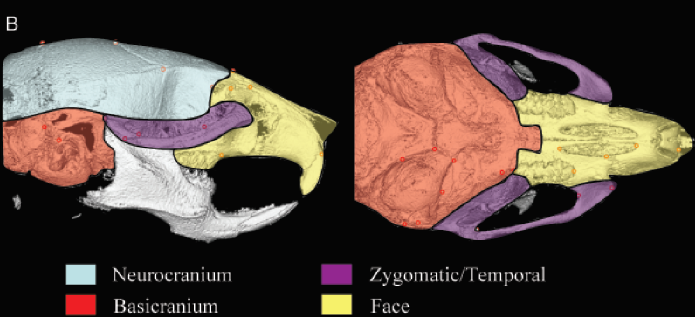
Developmental modules

Slide 11
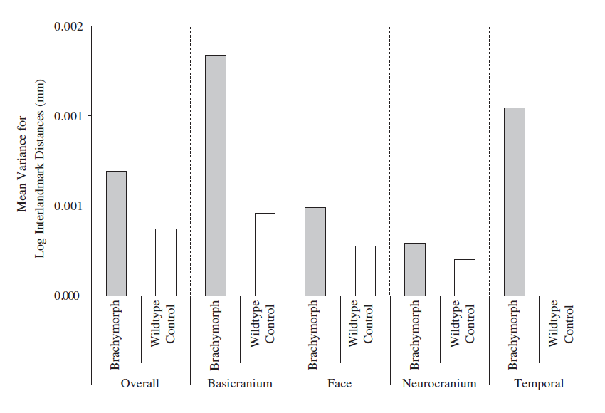
Divergent integration within developmental modules
WT and Bmp mutant matrix correlation = 0.3

Slide 12
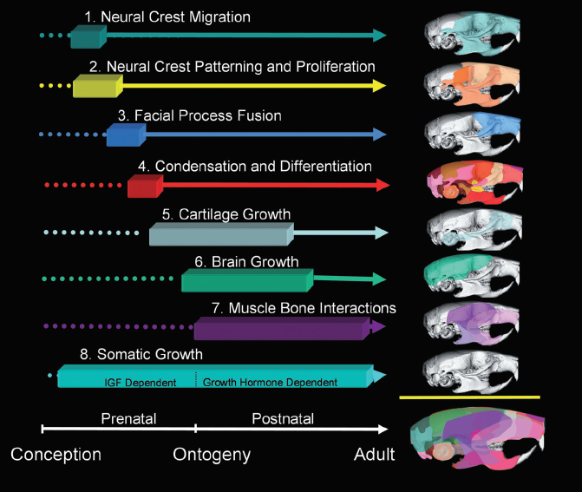

Slide 13
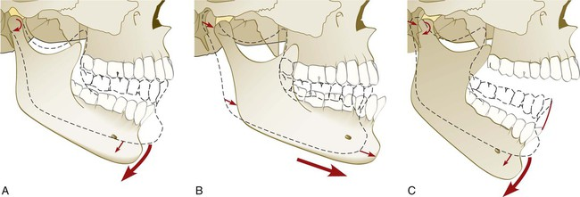
Remodeling:
functional to developmental modularity
Corruccini and Beecher 1982

Slide 14
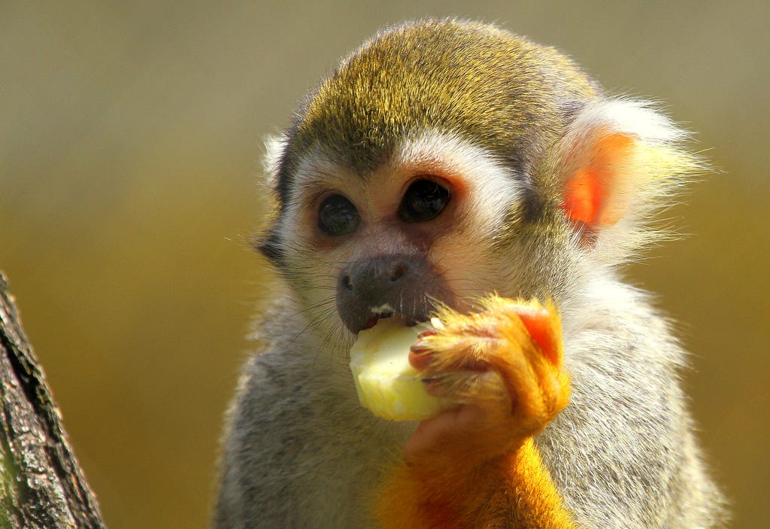
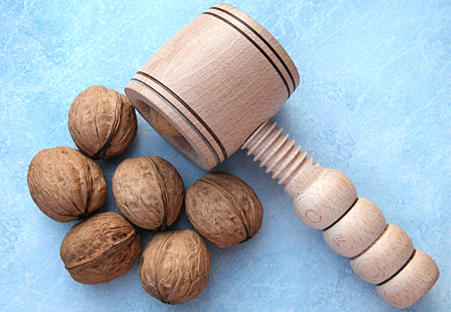
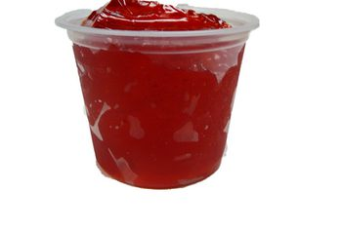
Divergent masticatory demands and occlusal development
N = 22
N = 17

Slide 15
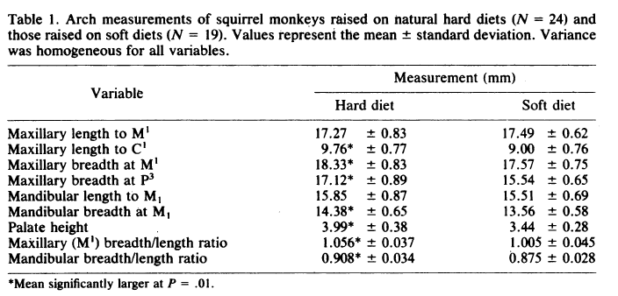
Mean trait correlation in soft diet = 0.48
Mean trait correlation in hard diet = 0.68

Slide 16
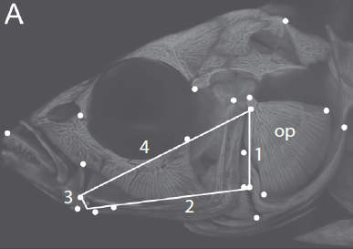
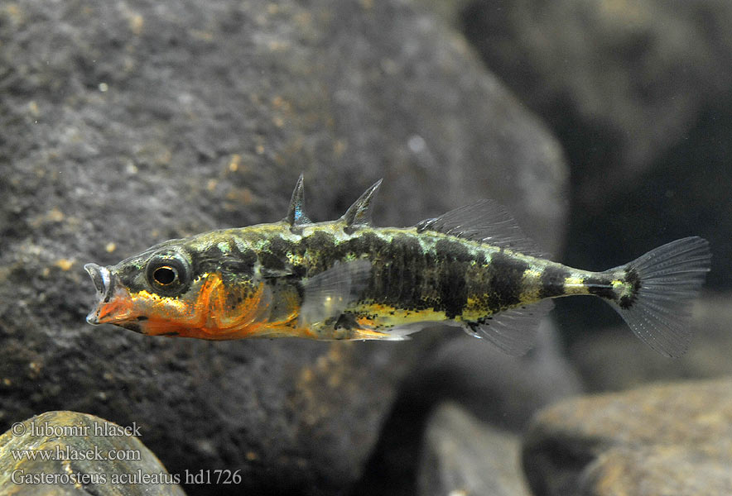
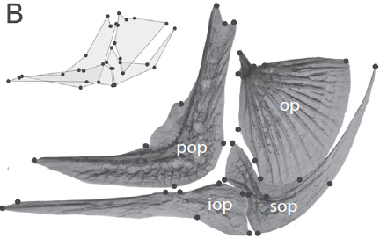
Performace selection:
functional to evolutionary modularity
Three-spined sticleback
Opercular four bar lever
Jamnickzy et al.2014

Slide 17
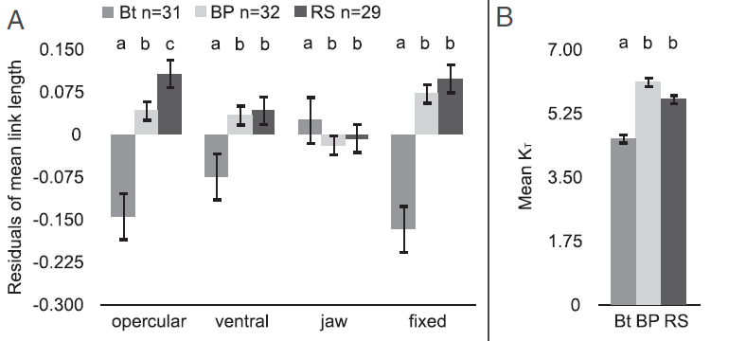
Biomechanical differences in the 4-bar lever
marine ancestral
transmission coeficient (mechanical efficiency)

Slide 18
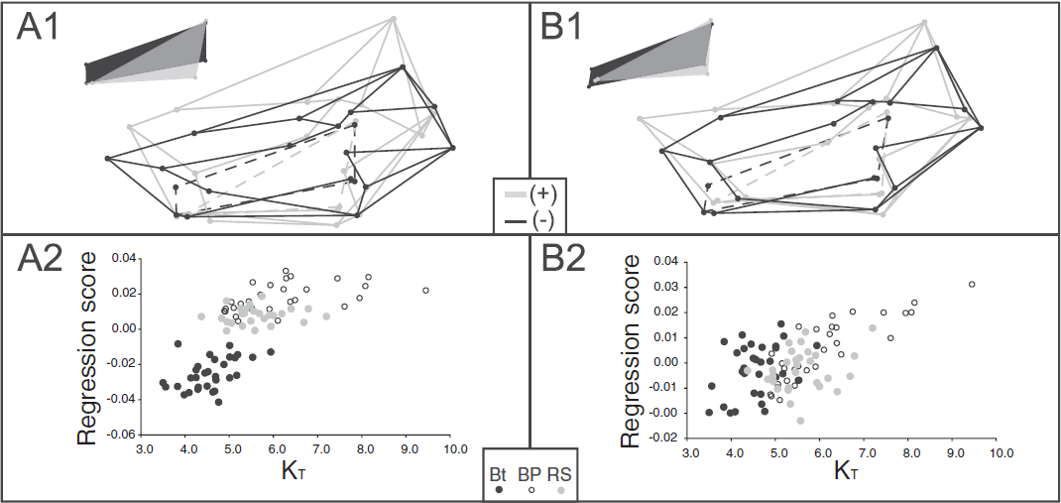
Shape variation explains variation in KT

Slide 19
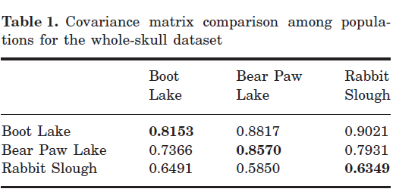
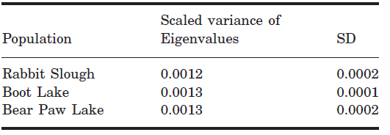
Stability of pattern and magnitudes across populations

Slide 20
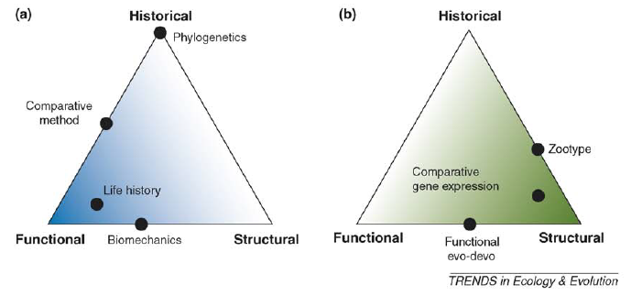
Functional Evo-Devo
‘However, if the goal is to gain na integrated view of the role of development in evolution, the link to function is essential’. (Breucker et al. 2006)

Slide 22
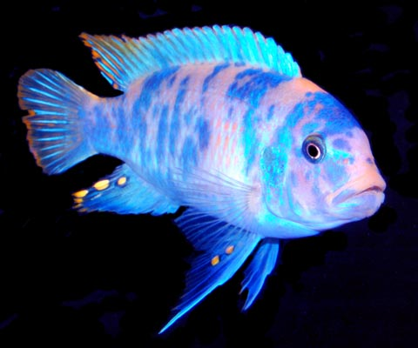
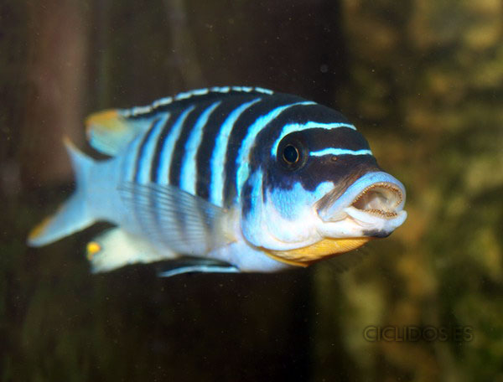
Evolution by selection:
functional to genetic to developmental modularity
MZ: Suction feeder
LF: Biting feeder
Albertson et al.2005

Slide 23
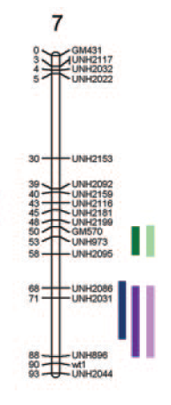
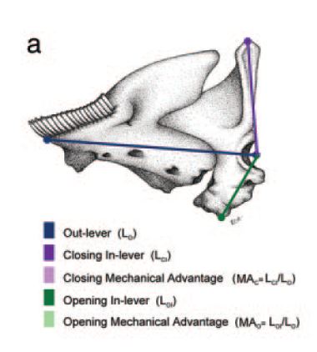
Genetic basis of jaw opening and closing
X
F2
QTL mapping

Slide 24
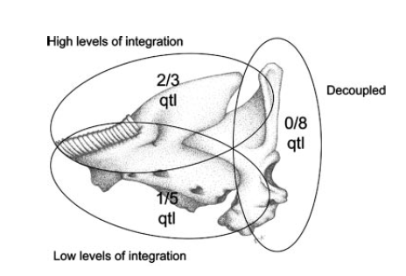
Out-lever and closing in-lever
Closing
and
Opening
in-lever
Out-lever and opening in-lever

Slide 25
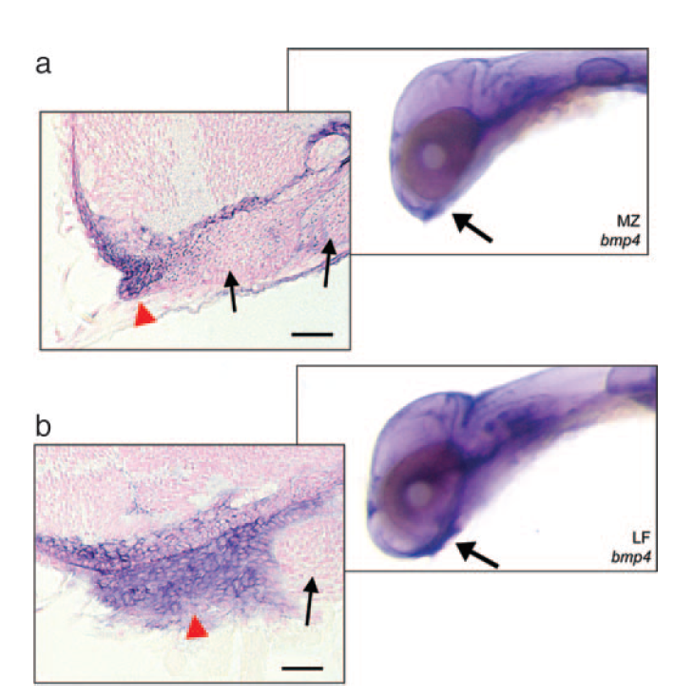
Divergent bone morphogenetic 4 expression

Slide 26
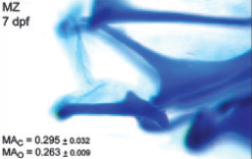
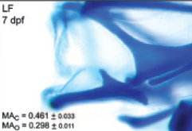
Divergent feeding biomechanics
Selection within populations
Genetic decoupling
of functional modules
Developmental
modification
Differential expression of bmp4
Species
differences

Slide 27
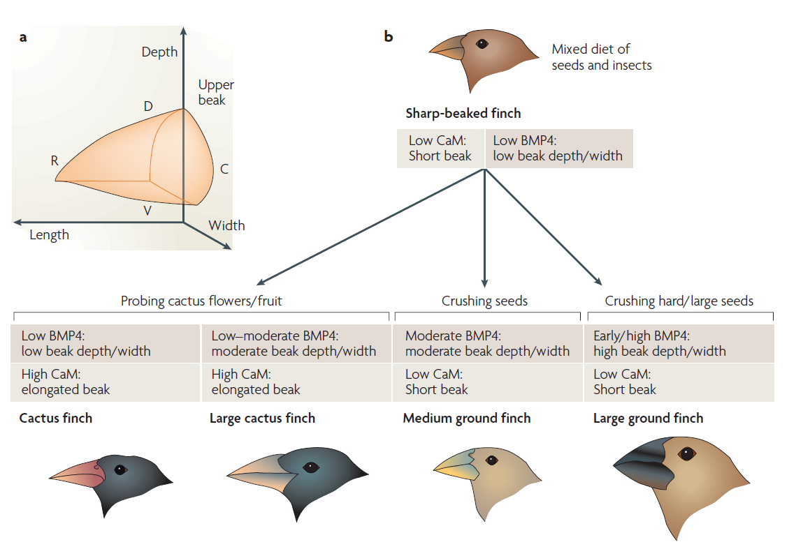
Abzhanov et al.2006

Slide 28
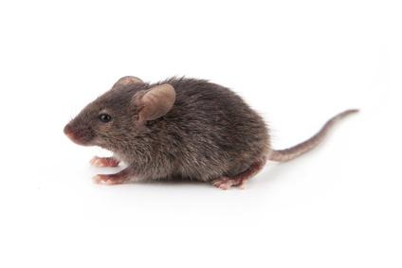
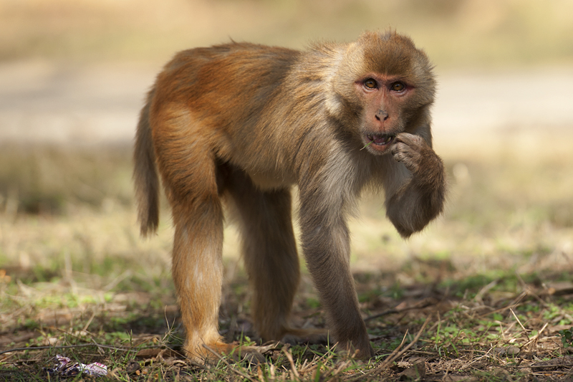
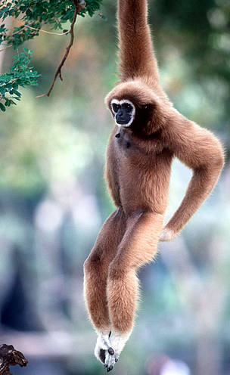
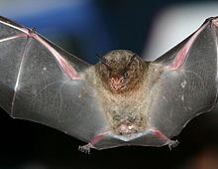
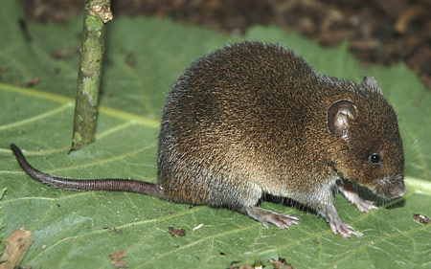
Young and Hallgrímsson 2005
Evolution by selection:
functional to developmental to evolutionary modularity

Slide 29
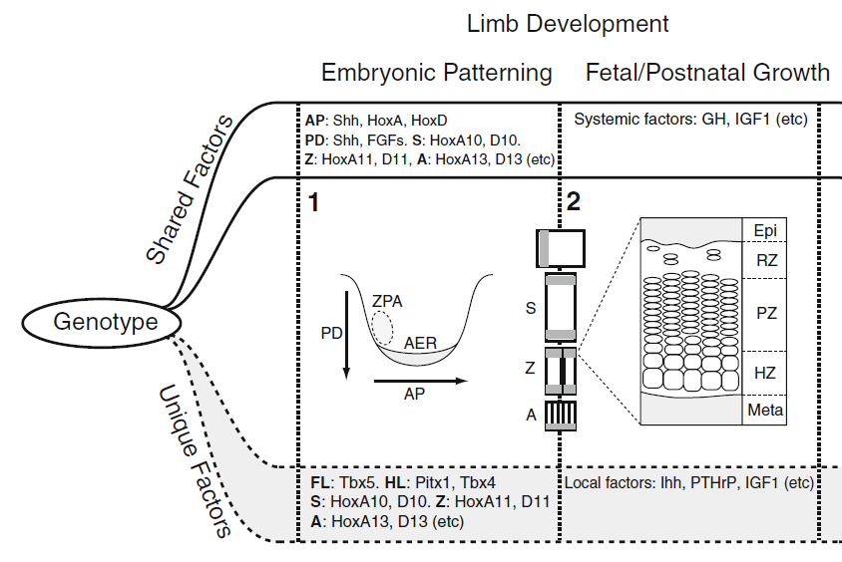

Slide 30
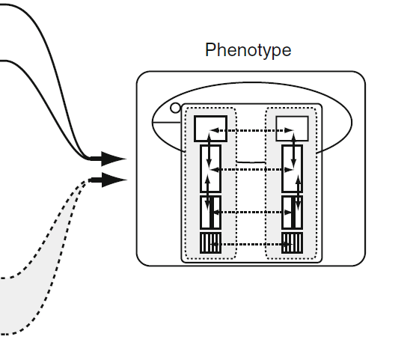

Slide 31
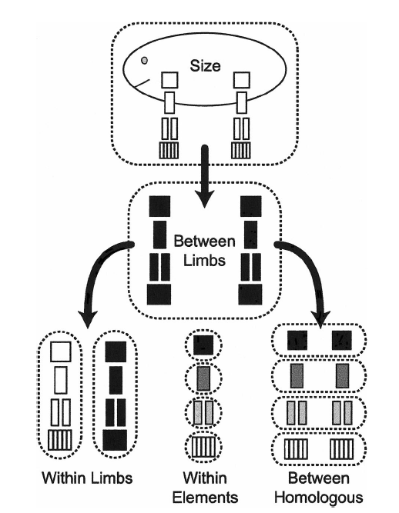

Slide 32
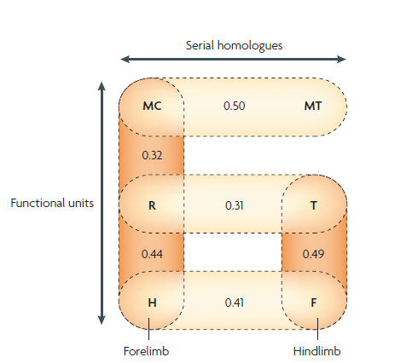

Slide 33
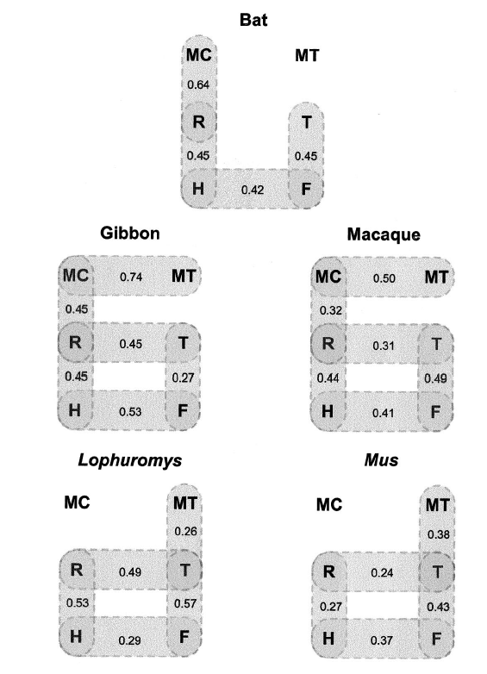

Slide 34
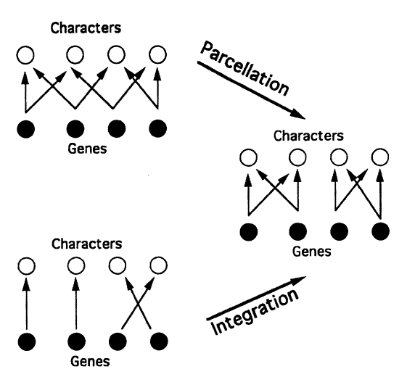

Slide 35
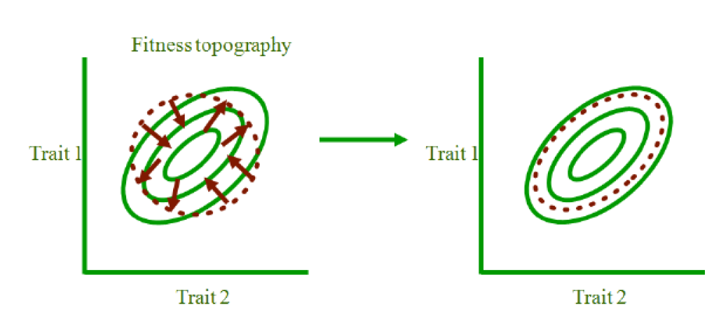
Quantitative genetics models:
Riedl’s hypothesis
Riedl 1977; Lande 1980; Cheverud 1984

Slide 36
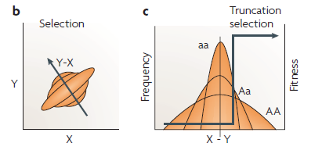

Slide 37
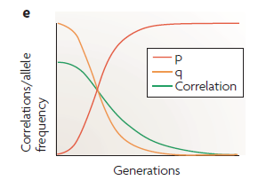

Slide 38

Developmental plasticity:
developmental to genetic modularity
González et al. 2010
LATE MALNUTRITION:
Pups: low protein diet
CONTROL:
diet ad. libitum
EARLY MALNUTRITION:
Dams: ½ control diet
TOTAL MALNUTRITION:
Dams + pups

Slide 39


Slide 40

Morphological changes aligned
with ontogenetic variation

Slide 41

Genetic and environmental effects:
same developmental pathways

Slide 42


Slide 43

Genetic assimilation:
Selection promoting increased canalization
Genetic variation in the response to malnutrition stress across individuals

Slide 44



Slide 45
Bibliografia
1. Abzhanov, A., Kuo, W.P., Hartmann, C., Grant, B.R., Grant, P.R. & Tabin, C.J. 2006. The calmodulin pathway and evolution of elongated beak morphology in Darwin’s finches. Nature 442: 563–567.
2. Albertson, R.C., Streelman, J.T., Kocher, T.D. & Yelick, P.C. 2005. From The Cover: Integration and evolution of the cichlid mandible: The molecular basis of alternate feeding strategies. Proceedings of the National Academy of Sciences 102: 16287–16292.
3. Berg, Raissa L. 1960. The Ecological Significance of Correlation Pleiades. Evolution 14: 171–180.
4. Breuker, C.J., Debat, V. & Klingenberg, C.P. 2006. Functional evo-devo. Trends in Ecology & Evolution 21: 488–492.
5. Cheverud, J.M. 1996. Developmental integration and the evolution of pleiotropy. American Zoologist 36: 44–50.
6. Cheverud, James M. 1988. A Comparison of Genetic and Phenotypic Correlations. Evolution 42: 958–958.
7. Cheverud, James M. 1984. Quantitative Genetics and Developmental Constraints on Evolution by Selection. Journal of Theoretical Biology 110: 155–171.
8. Cheverud, J.M. 1982. Phenotypic, Genetic, and Environmental Morphological Integration in the Cranium. Evolution 36: 499.
9. Gonzalez, P.N., Oyhenart, E.E. & Hallgrímsson, B. 2011. Effects of environmental perturbations during postnatal development on the phenotypic integration of the skull. Journal of Experimental Zoology Part B: Molecular and Developmental Evolution 316B: 547–561.

Slide 46
10. Hallgrímsson, B., Brown, J.J., Ford-Hutchinson, A.F., Sheets, H.D., Zelditch, M.L. & Jirik, F.R. 2006. The brachymorph mouse and the developmental-genetic basis for canalization and morphological integration. Evolution & development 8: 61–73.
11. Hallgrímsson, B., Jamniczky, H., Young, N.M., Rolian, C., Parsons, T.E., Boughner, J.C., et al. 2009. Deciphering the Palimpsest: Studying the Relationship Between Morphological Integration and Phenotypic Covariation. Evolutionary Biology 36: 355–376.
12. Jamniczky, H.A., Harper, E.E., Garner, R., Cresko, W.A., Wainwright, P.C., Hallgrímsson, B., et al. 2014. Association between integration structure and functional evolution in the opercular four-bar apparatus of the threespine stickleback, Gasterosteus aculeatus (Pisces: Gasterosteidae). Biological Journal of the Linnean Society 111: 375–390.
13. Klingenberg, C.P. 2008. Morphological Integration and Developmental Modularity. Annual Review of Ecology, Evolution, and Systematics 39: 115–132.
14. Olson, E. C. & Miller, R. L. 1958. Morphological Integration, 1st ed. The University of Chicago Press.
15. Porto, A., de Oliveira, F.B., Shirai, L.T., De Conto, V. & Marroig, G. 2009. The Evolution of Modularity in the Mammalian Skull I: Morphological Integration Patterns and Magnitudes. Evolutionary Biology 36: 118–135.
16. Young, N.M., Hallgrímsson, B. & Janis, C. 2005. Serial homology and the evolution of mammalian limb covariation structure. Evolution 59: 2691–2704.

